Slide 1
Quantum Computers…When?
We do not yet have large scale general-purpose quantum computers, though many approaches are being pursued.
?
Quantum computers are 25 years in the future and always will be.

Slide 2
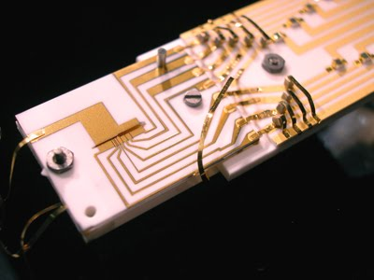
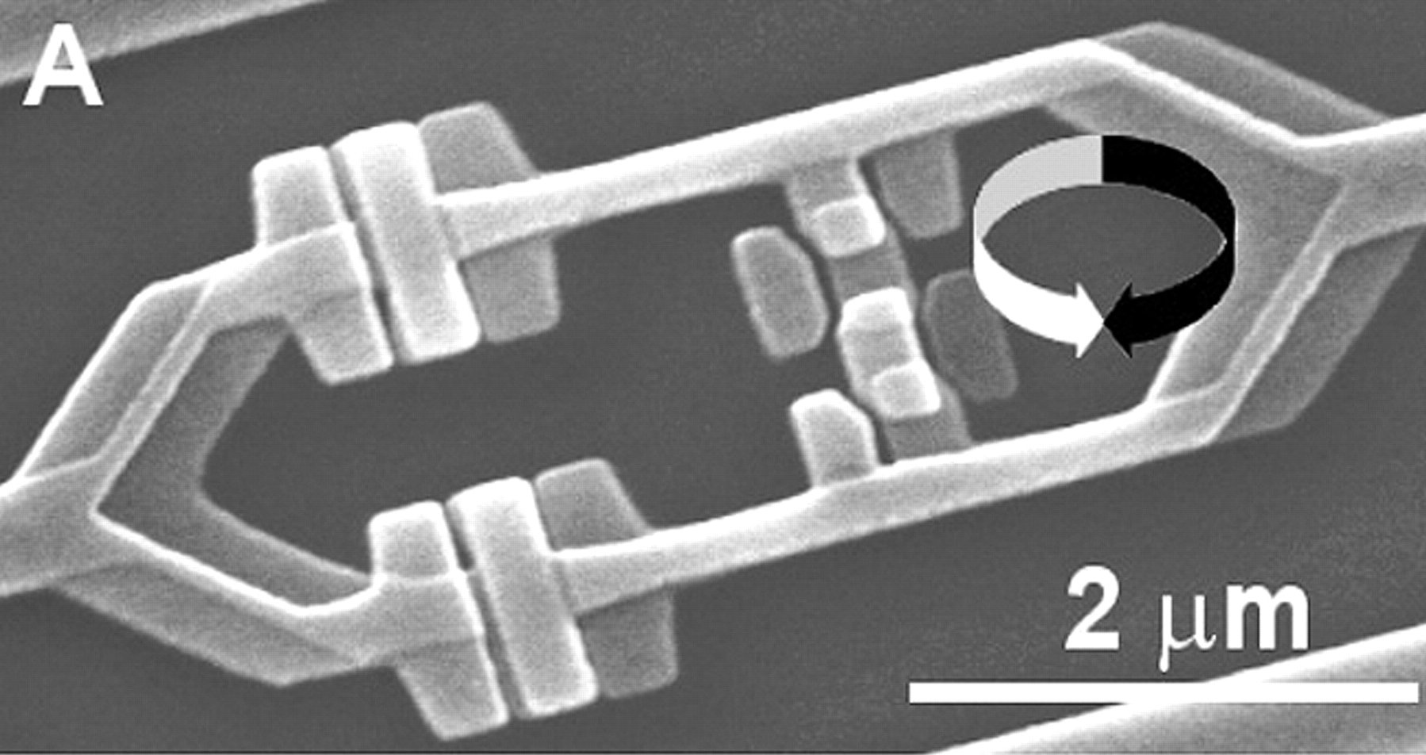
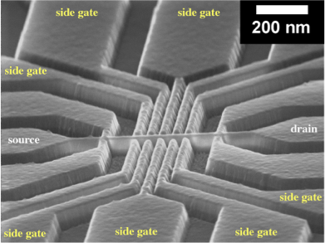
Quantum Computers…When?
We do not yet have large scale general-purpose quantum computers, though many approaches are being pursued.
?
Quantum computers are 25 years in the future and always will be.
Trapped Ions
Superconducting Circuits
Quantum Dots
...
[ Wineland group, NIST ]
[ Mooij group, TU Delft]
[Paul group, U. Glasgow ]

Slide 3
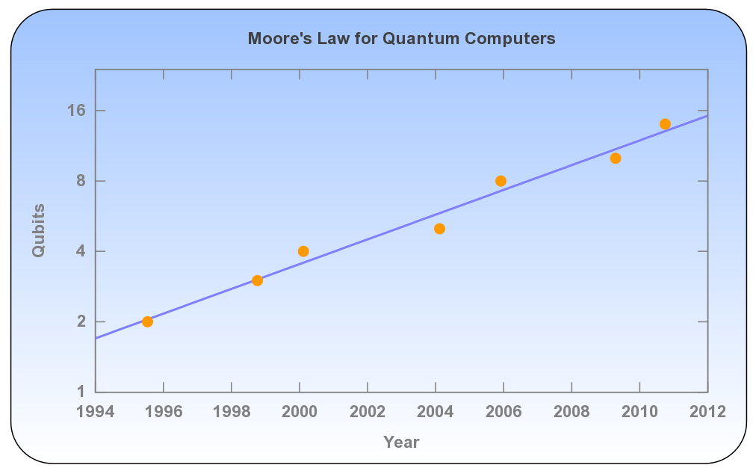
A Frequently Made Argument
Quantum Moore's law: Number of qubits doubles every 6 years.
My opinion: Number of qubits is the wrong metric.

Slide 4
Why is it hard to build a quantum computer?
Quantum states are very fragile and must be extremely well isolated.
In the early days, many prominent scientists thought that quantum computation was doomed for this reason. (analog computing, anyone?)
A 1996/1997 breakthrough convinced all but diehard skeptics that quantum computation is scalable, in principle.

Slide 5
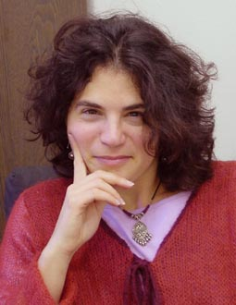
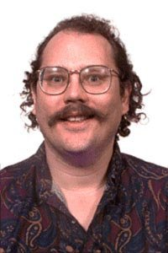
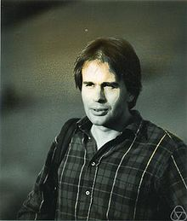
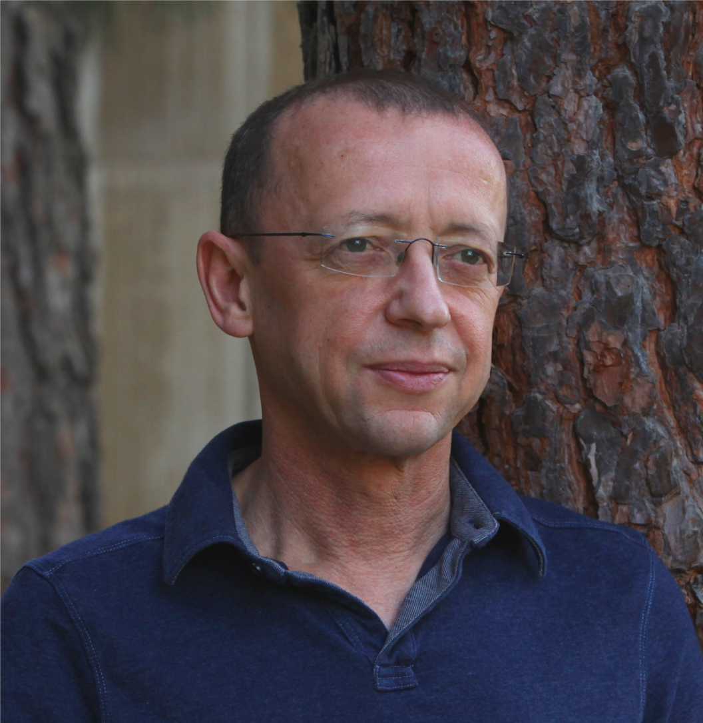
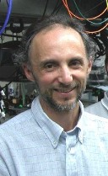
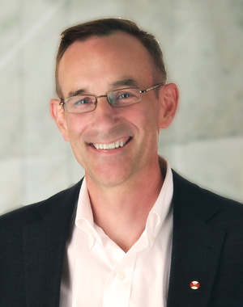
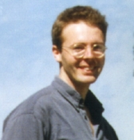
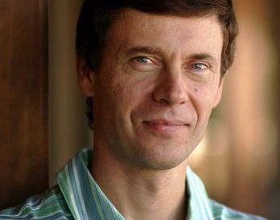
Threshold Theorem
Theorem (loosely stated): If error per
quantum operation can be brought below 0.5%,
arbitrarily long quantum computations can be
performed by correcting errors as you go.
Aharonov
Ben-Or
Shor
Calderbank
Kitaev
Laflamme
Steane
Knill

Slide 6
Progress in Quantum Computing
Threshold
Theorems
Experimental
Error Rates
0.0001%
(1997)
0.5%
(2015)
5%
(1995)
Theorists improve error correction schemes
to tolerate higher error rates
Experimentalists achieve lower error rates.
When these numbers meet we can think about scaling up.

Slide 7
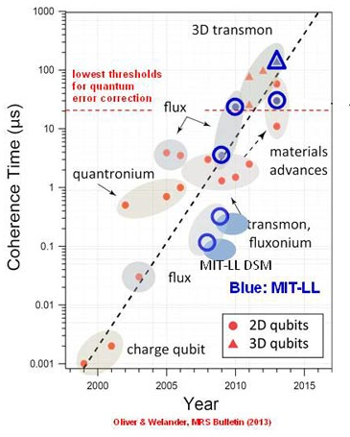
A Real Quantum Moore's Law
Superconducting Qubits:
Coherence time doubles
every 11 months.
Roughly equivalent:
Error rate halves
every 11 months.

Slide 8
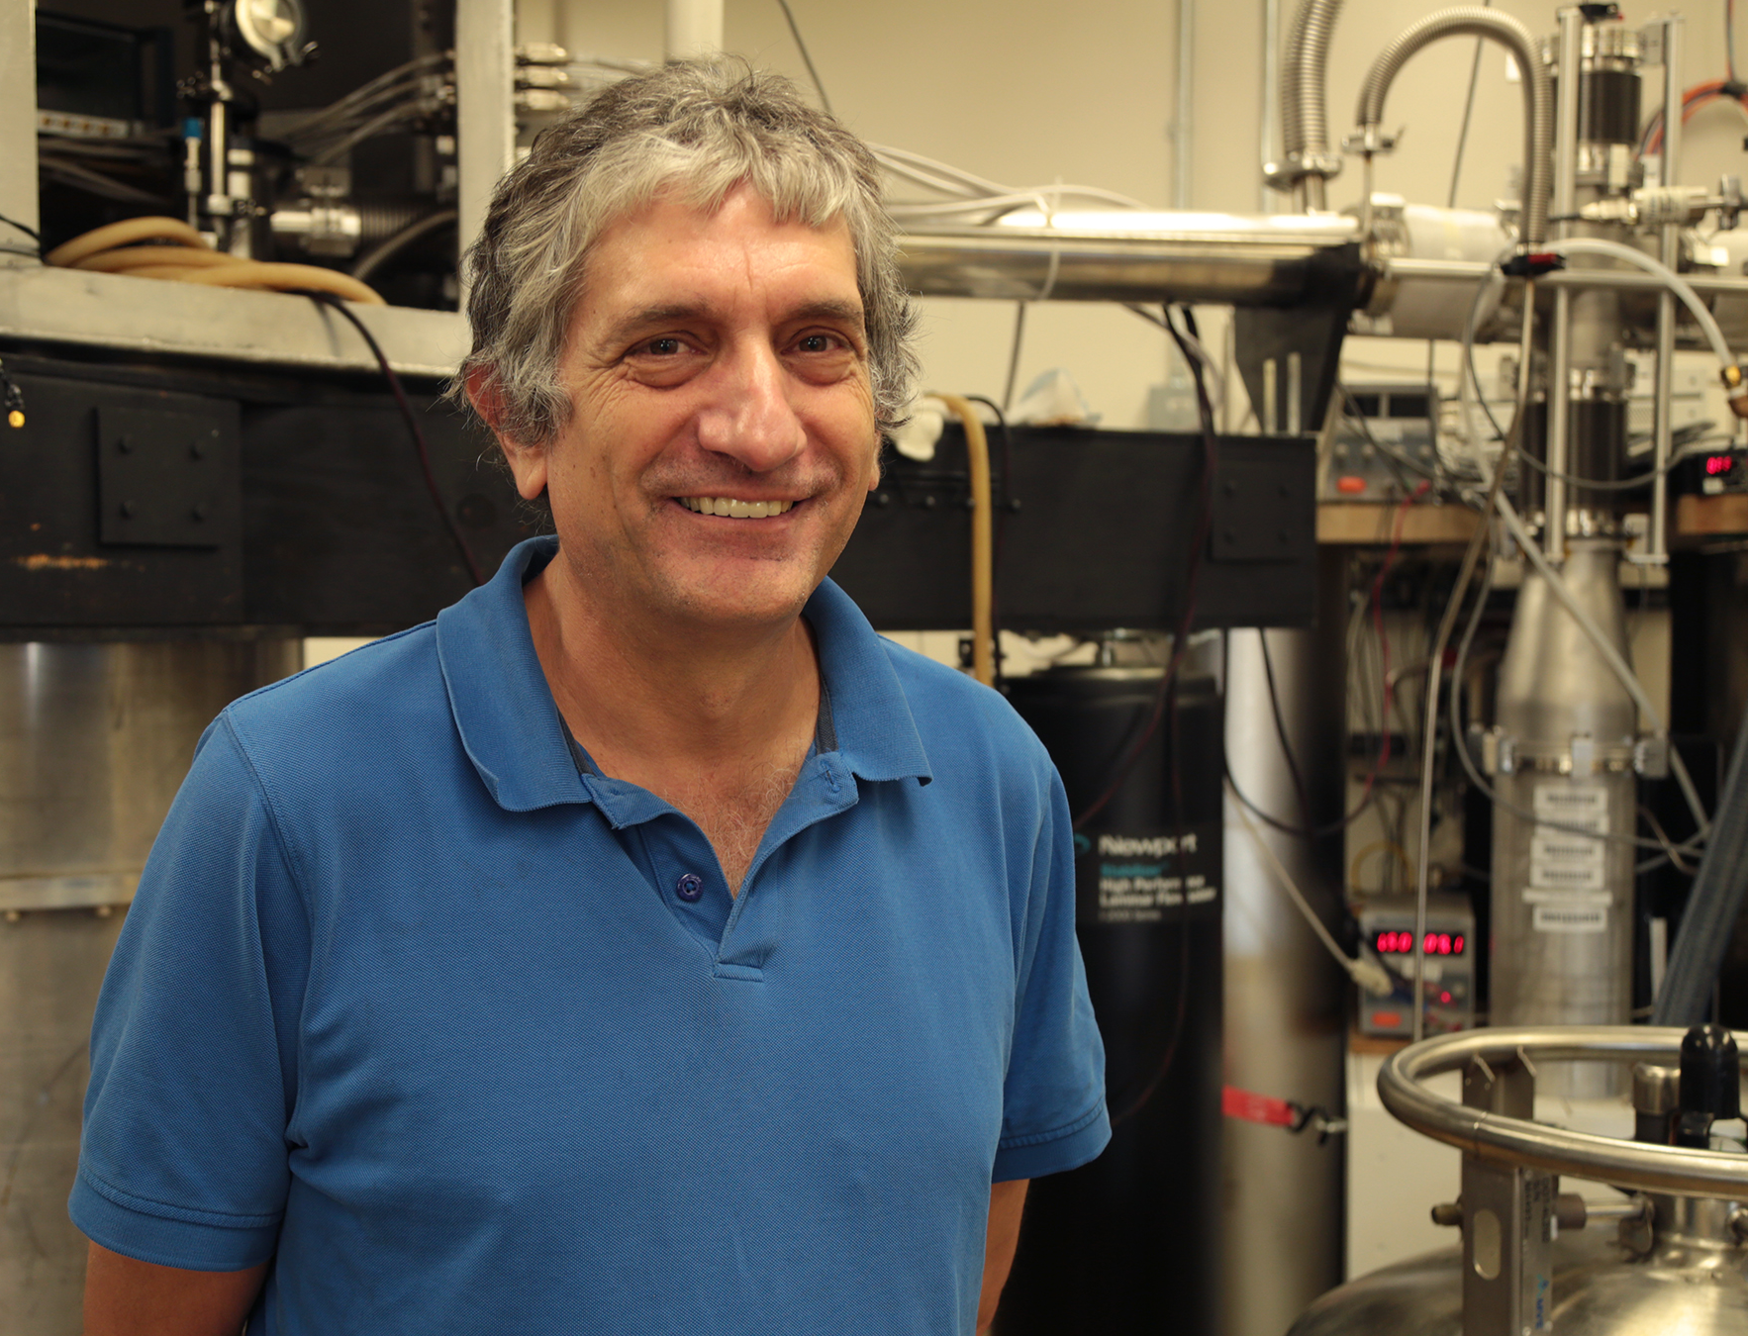
April, 2014

Slide 9
-March, 2014 (Trapped ion qubits):
Lockheed-Martin/University of Maryland quantum
engineering center announced
-April, 2014 (Superconducting qubits):
Martinis threshold paper
-September, 2014 (Superconducting qubits):
Google buys Martinis Lab
-October, 2014 (Silicon-based qubits):
Morello & Dzurak at University of New South
Wales announce 99% gate fidelities
-November, 2014 (Trapped ion qubits):
Oxford announces Q20:20 project
-April, 2015 (Superconducting qubits):
IBM demonstrates error detecting codes
So does Delft University of technology

Slide 10
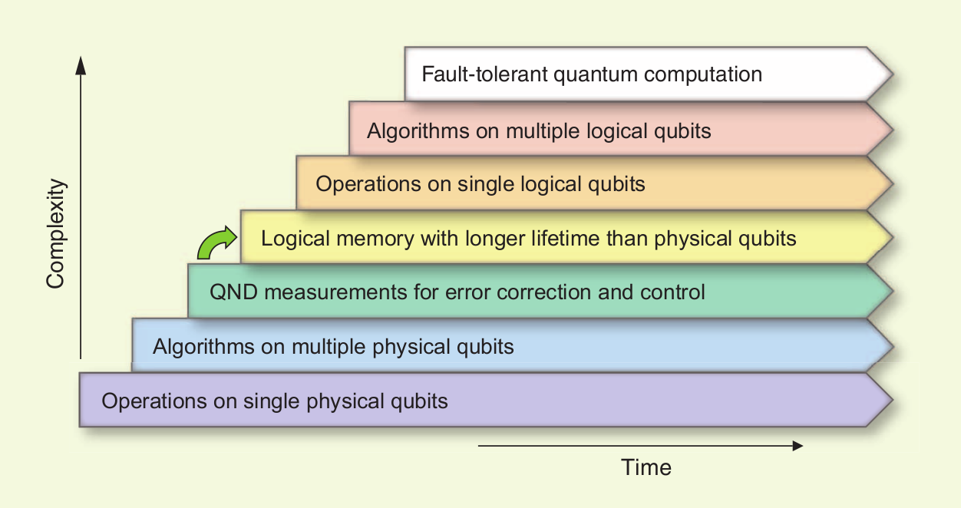
[Image credit: M. Devoret and R. Schoelkopf]
We've made a lot of progress, but we've still
got a long way to go.

